Slide 1
EECE 387 Final Project:
Metal Detector
Ron Alweiss, Daniel Bondar, Peyton Lane, Frank Nardi, Jeremiah Phillips

Slide 2
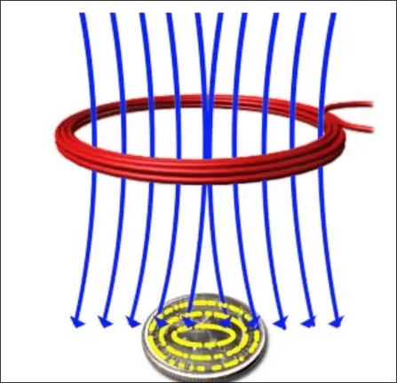
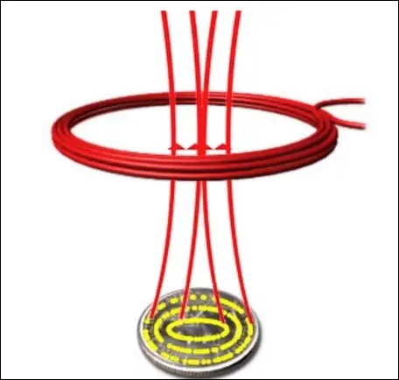
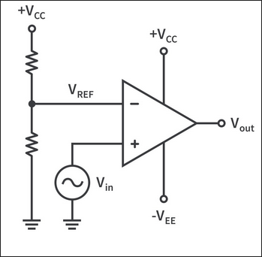
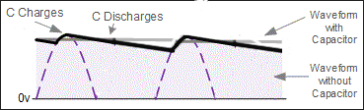
Hardware Implementation
Eddy currents induced into metallic object
by EMF from waveform on coil created by Colpitts oscillators
Eddy currents create their own EMF that changes inductance of coil
Change in inductance lowers the amplitude of Vin, causes pulses of shorter width, or removes pulses entirely at Vout
Pulses sent across capacitor to get a DC signal readable by Basys3 XADC
Notes:
Peyton

Slide 3
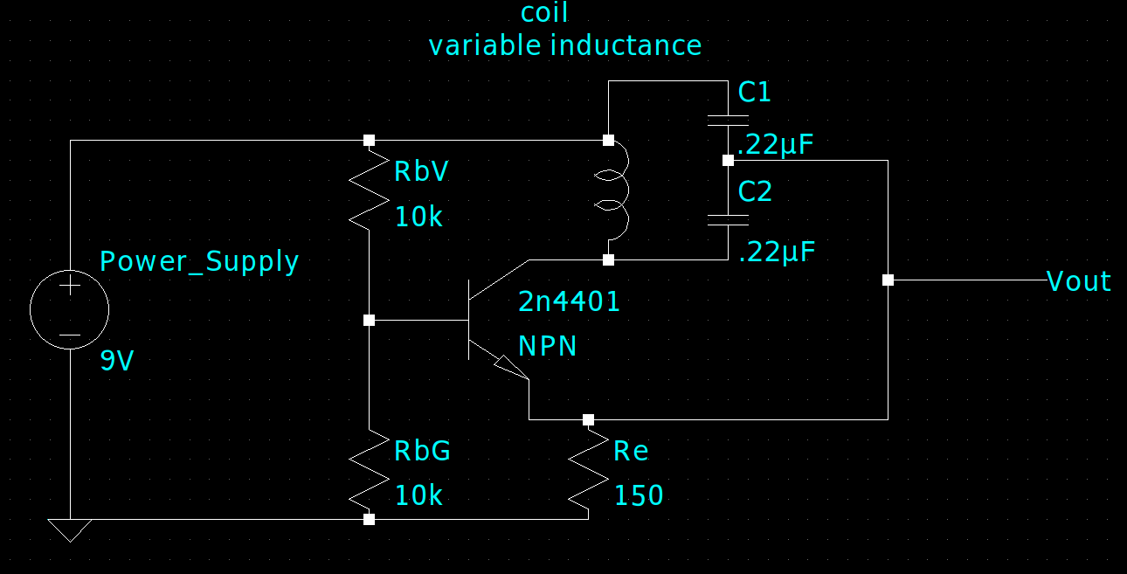
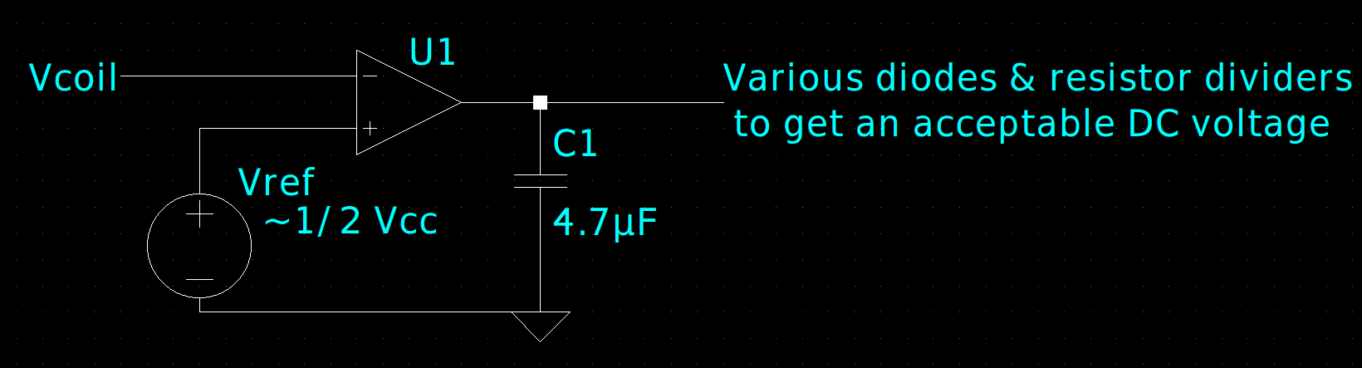
Hardware Design
Colpitts Oscillator
Pulse Generator
Same circuit for each coil
Varying components to “fix” the DC voltage are in place depending entirely on the output voltage of the coils. Vref varies as well.
Notes:
Ron

Slide 4
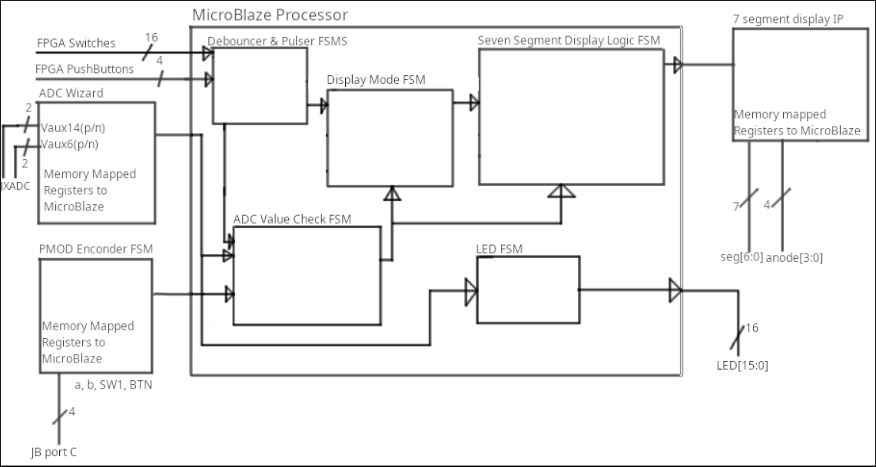
Block Diagram
Notes:
Jeremiah

Slide 5
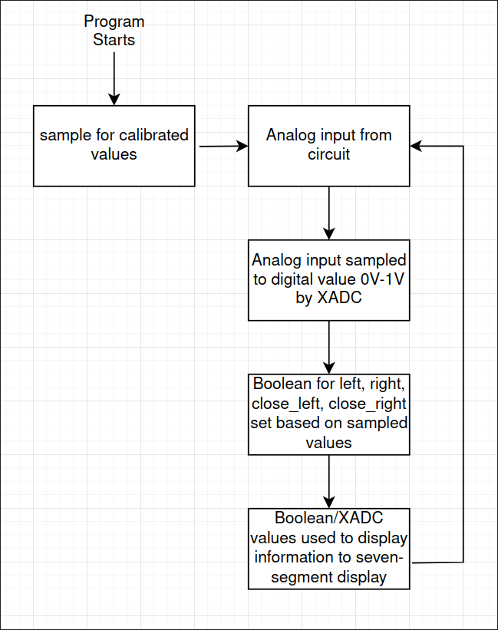
Software Process
Variables present-
Uint16_t adc1_cal,
Uint16_t adc2_cal,
Used to update:
_Bool adc1_digital,
_Bool adc2_digital,
_Bool is_close_left,
_Bool is_close_right,
All of which decide displayed data depending on display mode
Notes:
Frank

Slide 6
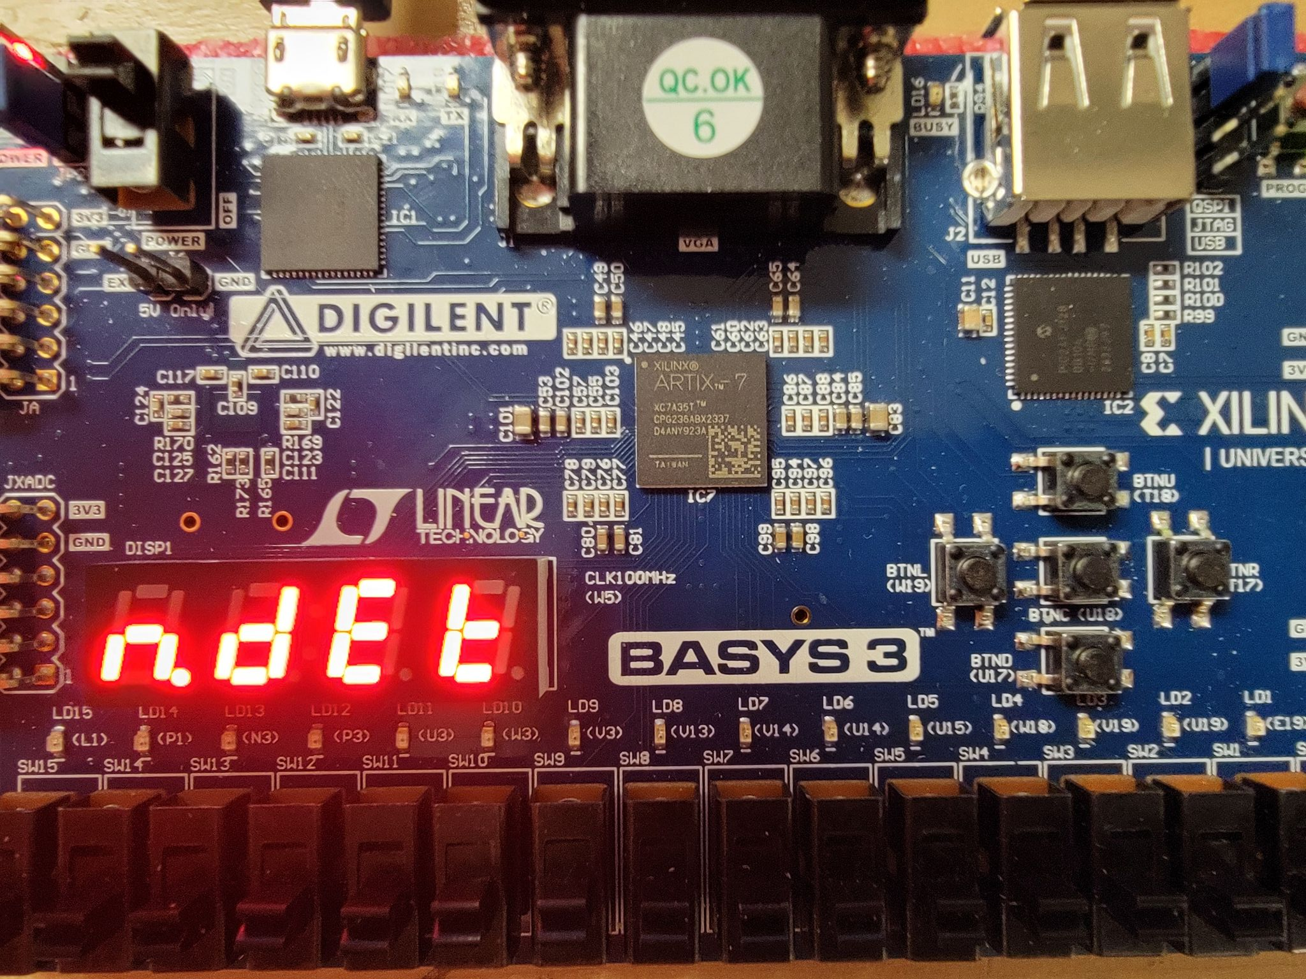
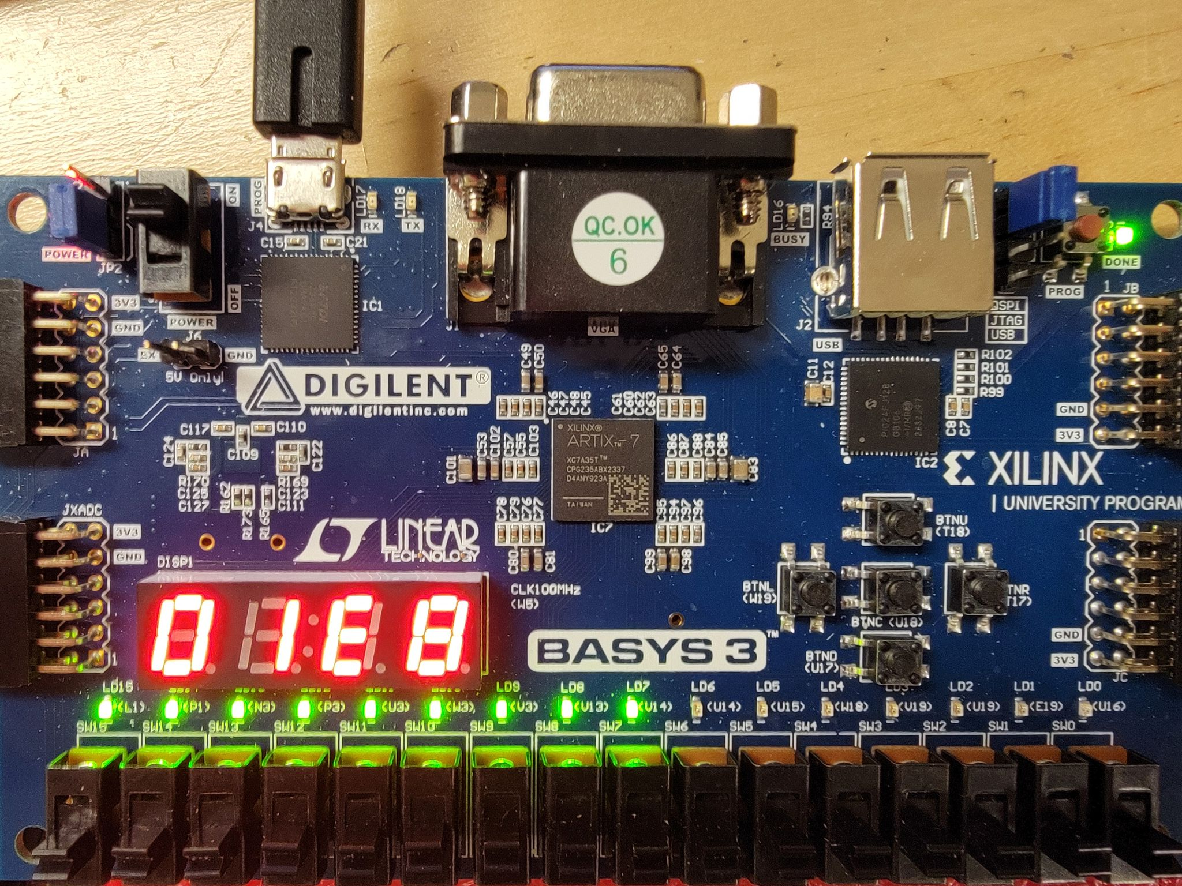
The 3 Interfacing Modes: Position, Strength, Count
Mode 1. Position
Mode 2. Strength
“N.det”, “f.lft”, “left”, “rght”, “f.rgt”
Voltage drop in mV displayed in HEX
Notes:
Daniel

Slide 7
Power Analysis
Component | Voltage (V) | Current (mA) | Power Dissipated (mW)
Colpitts Oscillator #1 | 9 | 29 | 261
Colpitts Oscillator #2 | 9 | 29 | 261
5 V Regulator | 9 | 68 | 612
Regulator-to-Board Transition* | 4 (9 V - 5 V) | 114 | 456
Basys3 Board | 5 | 114 | 570
Total | 9 | 240 | 2160
Notes:
Ron

Slide 8
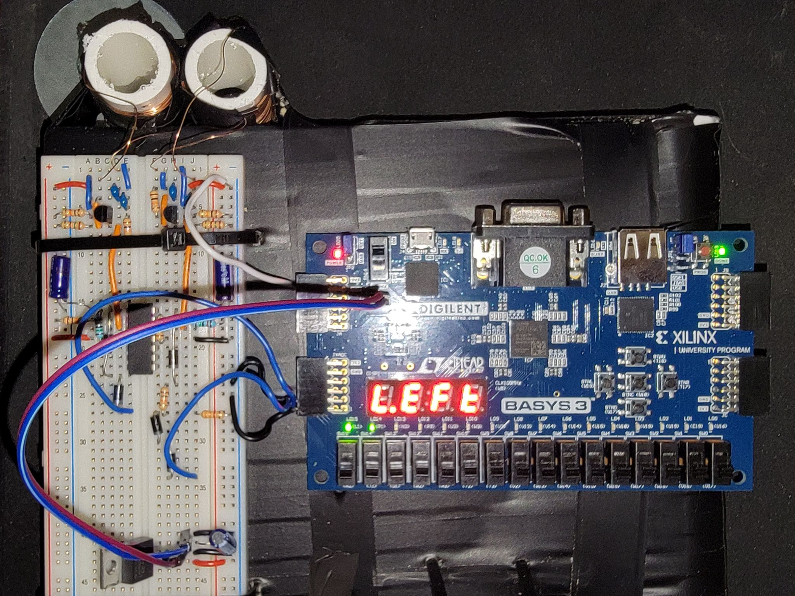
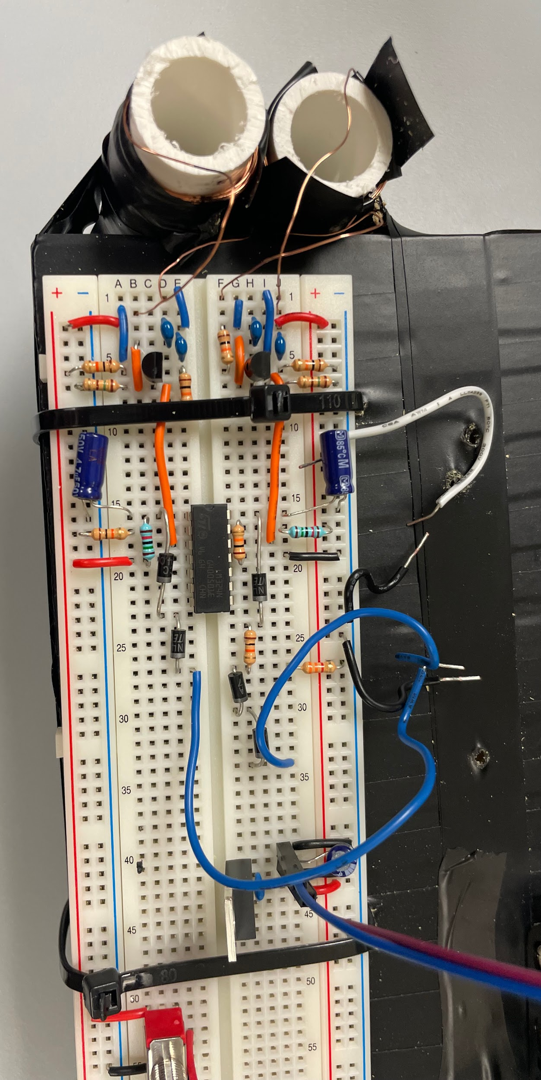
Demonstration Results
The metal detector successfully identified the metal washer in each position
  5 separate readings per position were all recorded by the system
Signal strength of the coils was measured by the system
  Displayed on the on-board LEDs with the varying distance between the washer and coils
Detecting Left
Circuit
Notes:
Frank

